Slide 1
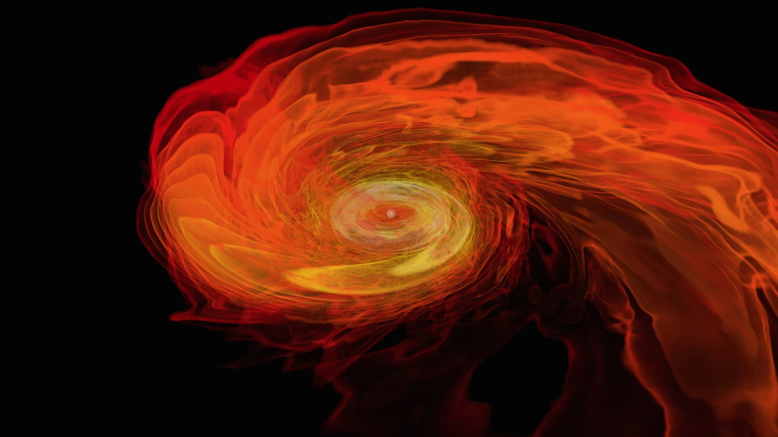
What can NS mergers tell us about dense matter?
M. Coleman Miller
University of Maryland, Astronomy Department
and
Joint Space-Science Institute

Slide 2

Outline
Why are radius measurements difficult?
Mass limits from GW170817 (if we make extra assumptions)
Another approach: NICER observations

Slide 3
Difficulties in measuring NS radii
Consider an ordinary star, like the Sun
Too far for angular resolution
But can get luminosity L
If we assume blackbody, R²=L/(4πσT⁴)
But for NS, usually gives ~5 km or less!
Why? Spectral shape is ~Planck, but unlike blackbody, emission is inefficient
Need good spectral models

Slide 4
Problem #1
Good spectral models do exist, and those models provide an excellent fit to the best data.
But the fit can be equally good for different compositions, with very different radius implications.
Catuneanu+ 2013, quiescent NS in M13
H atm: R=9^{+3.0}_{-1.5} km; He: R=14.6^{+3.5}_{-3.1} km
Equally good fits!

Slide 5
Problem #2
Maybe you can argue that H, or He, is more likely for a given star. Or maybe the star is hot; differences are smaller then.
But fits usually assume that the whole surface emits uniformly. Is that true? If it isn’t, does that introduce systematic error?
Could we tell based on pulsations, or fit quality?
Consider X-ray bursts from neutron stars...

Slide 6
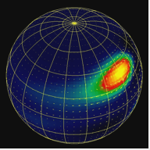
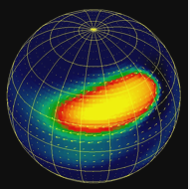
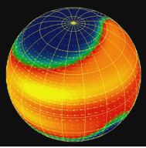
Axisymmetrization of Emission
Sequence of frames from movie by Anatoly
Spitkovsky of nuclear burning including Coriolis effect
In this model, burning becomes more axisymmetric
with time, but latitudinal variations remain
Note: brightness oscillations are seen in many burst tails
Would such a temperature variation lead to poor fits of
single-temperature models?

Slide 7
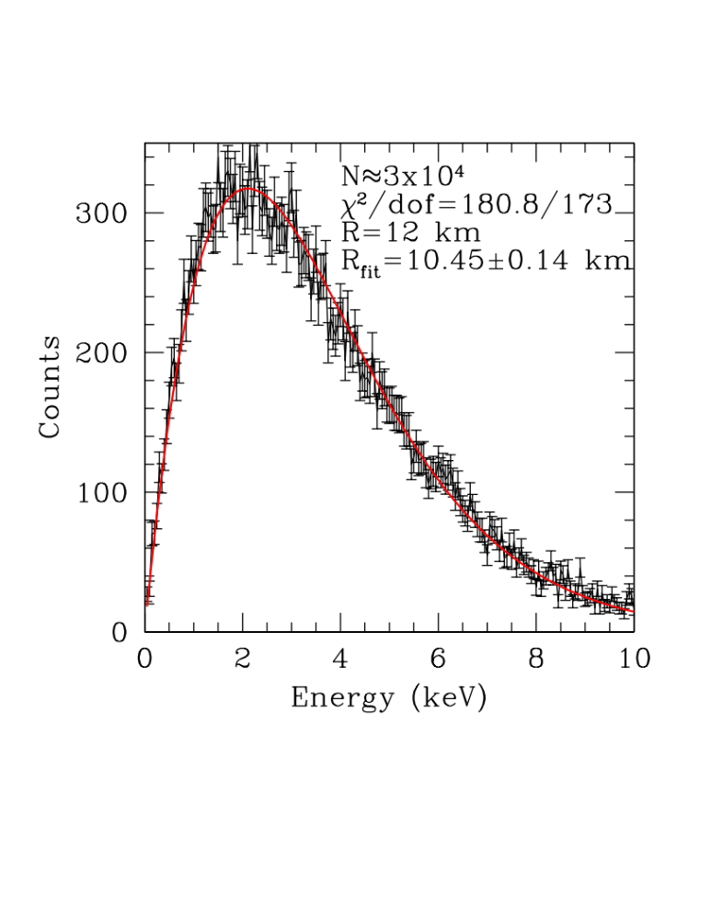
Radius Bias with T Variation
Example of the bias toward low radii from single-temp
fits to surface with varying temperature.
Temperature varies smoothly from 2 keV (equator) to 0.2 keV (pole).
Fit is good, but R is 13% low. With narrower T profile, correction is larger
Good fit and lack of pulsations does not guarantee uniformity!
Assume perfect energy response, zero N_{H}

Slide 8
Systematic Errors are a Problem
The result of this exercise, and of much more detailed work, is that we need to worry about systematic errors in many existing EM estimates of neutron star radii
There are some exceptions, e.g., the NICER results we’ll discuss later, but GW input is independent and welcome!

Slide 9
Some Caveats Regarding GW
The GW170817 radius results from tidal deformability are very promising, but:
As Jim Lattimer has pointed out, the role of the priors needs to be examined thoroughly
As Sathya points out, careful exploration of possible systematics is necessary
What can we do with GW170817 given some additional assumptions?

Slide 10
NS Mass Upper Limit?
Several papers prior to GW170817 argued for an improved upper limit to NS masses
These papers use the idea that for a NS-NS merger to produce a short GRB, there must be a quick collapse to a black hole

Slide 11

Short GRB as NS-NS Merger
Frame from NASA
simulation of NS-NS
merger; note the
outflowing gas
Murguia-Berthier et al. (2014) argue that a successful GRB requires collapse to BH in <0.1s; otherwise, ν wind increases duration
For GW170817, ~2 second GRB duration

Slide 12
The Idea
S. Lawrence et al. 2015, ApJ, 808, 186
(see also Bauswein et al. 2013; Fryer et al. 2015;
Margalit and Metzger 2017)
We suppose that we need rapid collapse, or a
ν-driven wind will load the jet with baryons and lengthen burst
Thus NS+NS mass must exceed maximum for rotating star (we assume uniformly rotating)
This also places an upper limit on the mass of a slowly rotating star (both depend on EOS)
Maximize using parameterized eqns of state
More precise if masses determined from GWs

Slide 13
From NS-NS to BH
When NSs merge, to make BH they have to have more mass than can be supported
Direct collapse to BH would not allow neutrino wind to increase Y_{e}, making optical
Two possibilities:
  Hypermassive NS: supported only because of differential rotation
  Supramassive NS: supported only because of uniform rotation
Hypermassive can be more massive, but the state is not expected to last long

Slide 14
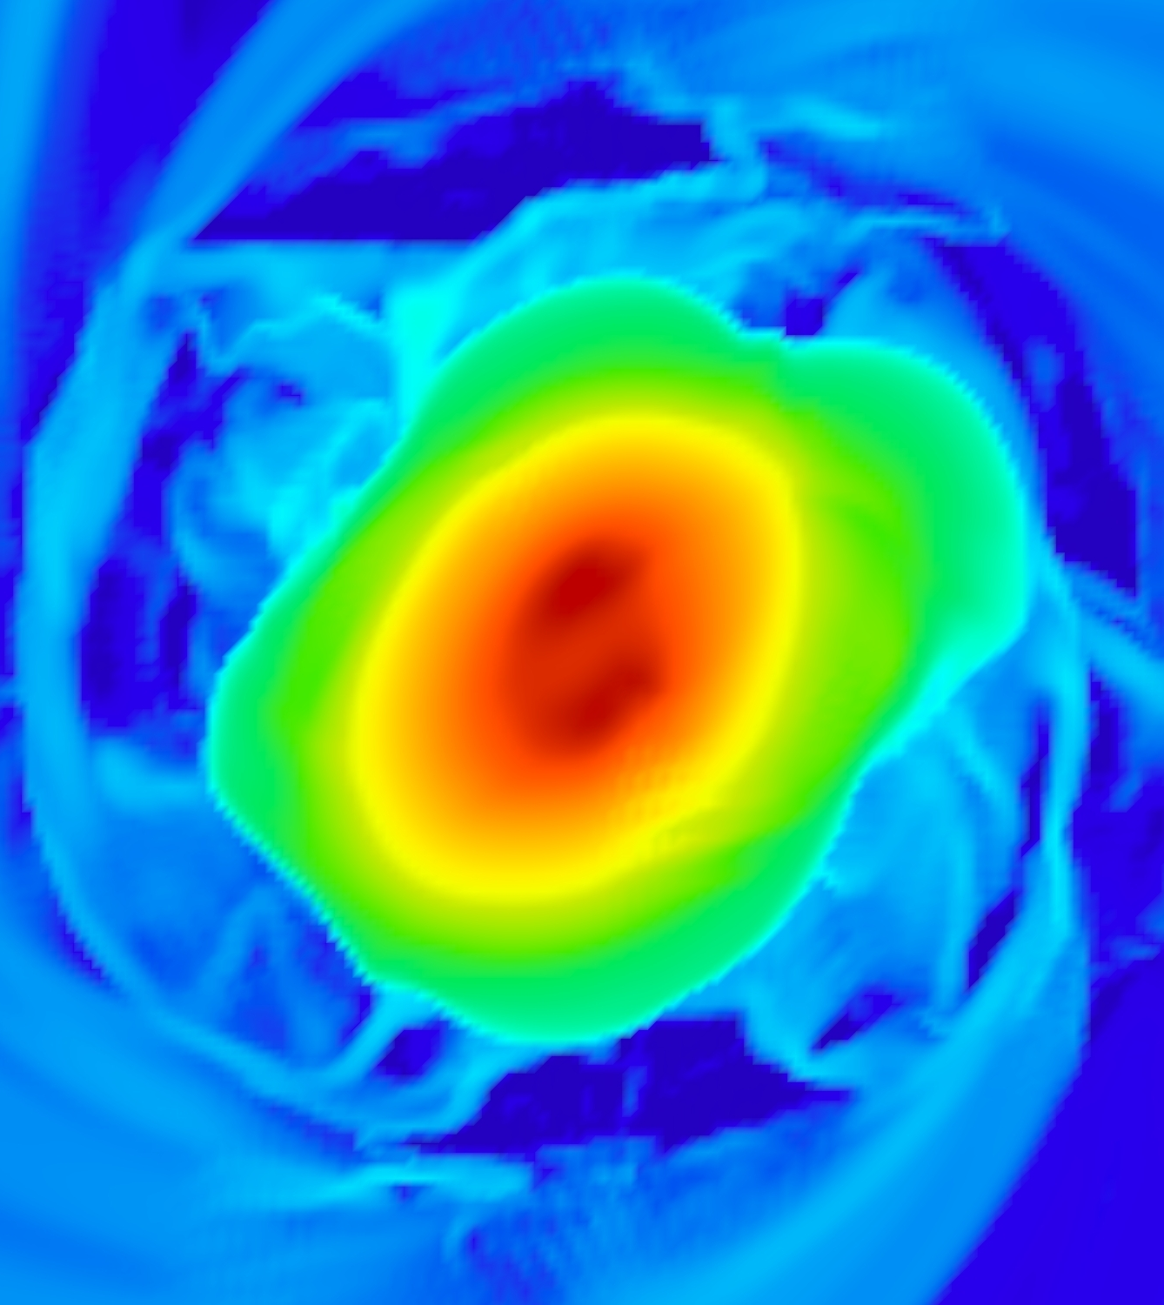
Step 1: Hypermassive NS
High angular momentum of binary NS leads to differential rotation
But internal B fields share angular momentum quickly
Uniform rotation in <0.1s, probably
Shapiro group, Univ. of Illinois

Slide 15
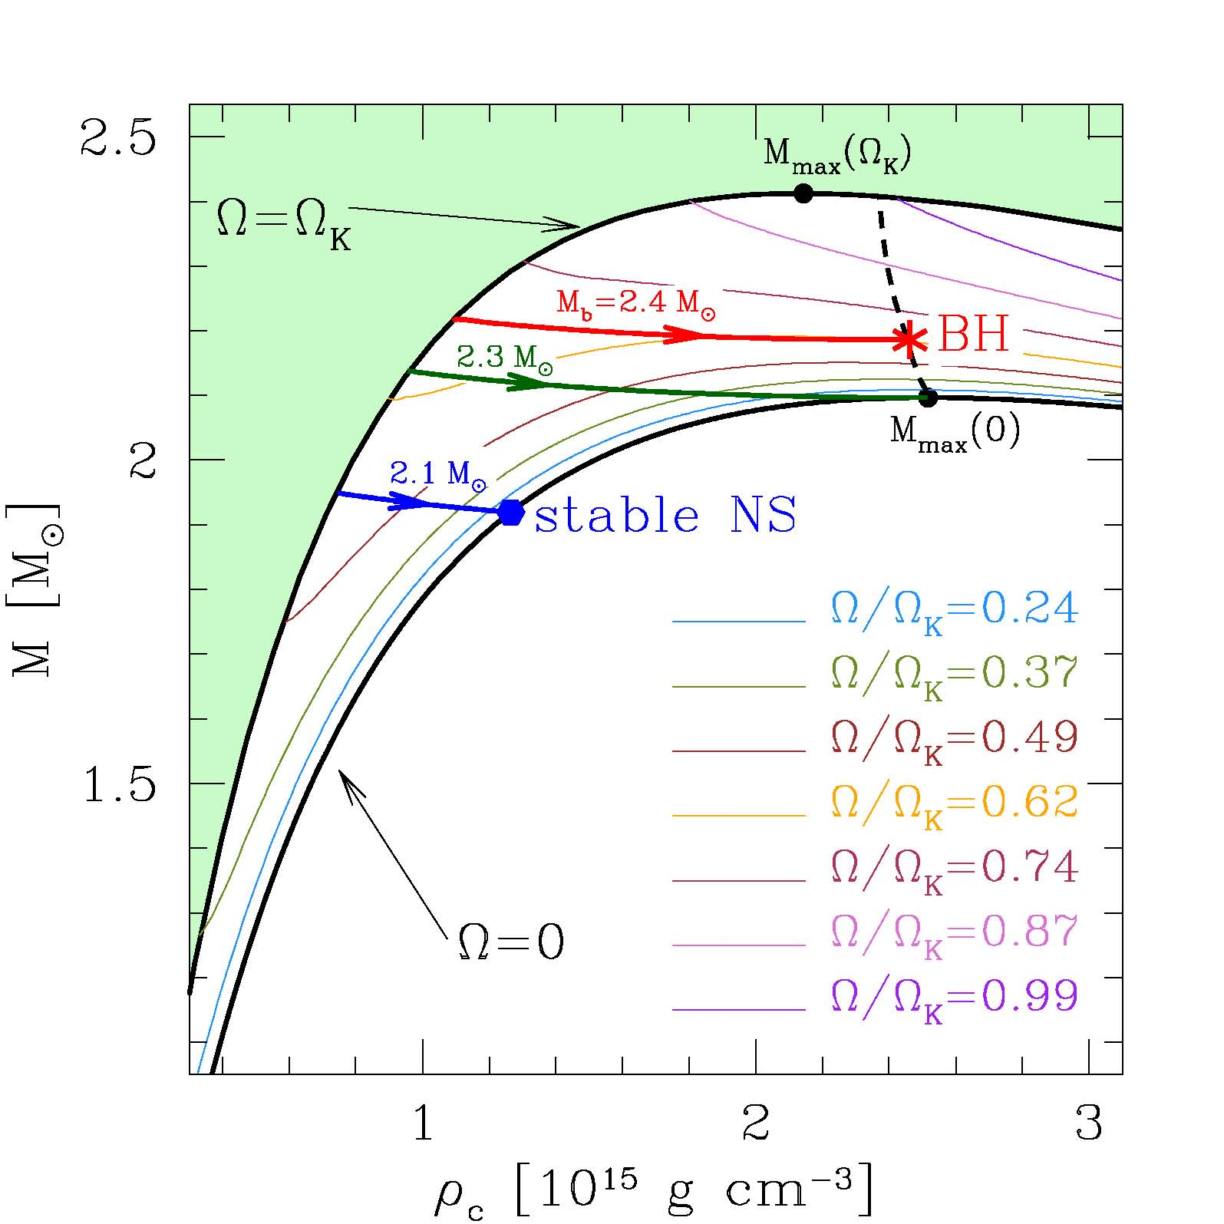
Step 2: Supramassive NS
When unif. rotation established, only net loss of angular momentum can slow down star
Takes years unless B field is very high (>10¹⁶ G needed for <0.1 second)
Falcke and Rezzolla 2013

Slide 16
Our Line of Argument
For collapse to BH, combined baryonic mass of the NSs must exceed the maximum that can be supported in a supramassive state
This places a limit on the equation of state
That limit translates to an upper limit on the mass of a nonrotating star
To get this limit, we need (1) a code to calculate stellar structures, (2) parameterized EOS, and (3) representative NS-NS masses

Slide 17
The Code
Rotating Neutron Star (RNS); Stergioulas and Friedman, plus later modifications by Jocelyn Read, Sharon Morsink, and others. Assumes uniform rotation
Any EOS can be input
Outputs mass (gravitational and baryonic), equatorial radius, maximum mass, etc. for any EOS, rotation rate, and central density

Slide 18
The Parameterized EOSs
We use two parameterizations of the EOS:
  The Read et al. (2009) piecewise polytropic EOS P(ρ); often used in GW applications
  A more recent EOS ε(ρ) based on Gandolfi et al. fits to elastic scattering data
The latter is probably more realistic; we double the error bars in all parameters
The former gives larger upper limits to mass, so is more conservative in that sense

Slide 19
For NS-NS, M_{chirp} ~gives M_{total}
From Lawrence et al. (2015)
If a binary has many GW cycles in-band, then the chirp mass M_{ch}=𝜂^{3/5}M_{tot} is measured precisely (M_{ch}=1.188 M_{sun} for GW170817), where 𝜂=M₁M₂/M²_{tot}
Minimum mass of NS (~1.1M_{sun}?) means that 𝜂 is close to its max of ¼, the value for equal masses; full range of uncertainty in M_{tot} is thus only a few hundredths of M_{sun}
Thus we know M_{tot} (gravitational) and have good estimate of M_{tot} (baryonic)

Slide 20
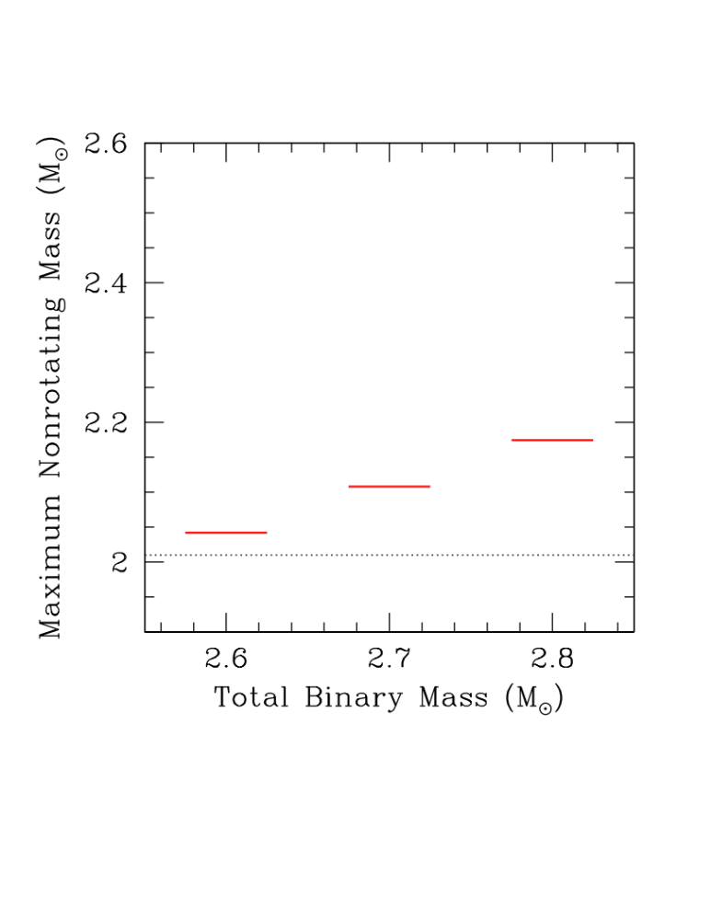
Example Results
Assume remnant rotates at mass-shedding limit
Lowest mass that we see will place strongest limit
For GW170817, results from Lawrence et al. would imply a limit of ~2.15 M_{sun}
Margalit & Metzger 2017 find M_{max}=2.17 M_{sun}
Fully consistent!
GW170817
Adapted from Lawrence et al. (2015)

Slide 21
Caution Required!
No definitive evidence of quick collapse
Metzger (2017) argues that B~10¹⁶ G is inevitable, thus rapid spindown and injection of spindown energy... but not clear
For example, if internal ang. mom. shared in ~10 ms, not much time for amplification
Not obvious what would be conclusive
Late-time injection of energy would mean NS
For a very high signal to noise event, there would be a difference in the GW ringdown

Slide 22
NICER
Electromagnetic observations will still have something to say
Results from the Neutron star Interior Composition ExploreR should be out later this year
The radius measurements are expected to be more precise than the results on GW170817 (<5% at 1 std dev)
Complementary results; a wonderful state of affairs!

Slide 23
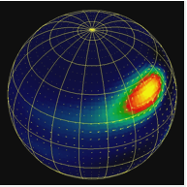
Ray Tracing and Waveforms
Rapidly rotating star
~200-600 Hz
v_{surf}~0.1-0.2c
SR+GR effects
Waveform is informative about both M and R
Must deal carefully with degeneracies
Figure from Anatoly Spitkovsky
Hot spot during an X-ray burst

Slide 24
Systematic Errors May Not Be A Problem for NICER
In addition to the <5% precisions expected with NICER observations, the systematic deviations examined so far aren’t as problematic as in other methods
This has been a major focus of the work I have done with Fred Lamb over the last five years
Examples: spot shape, spectrum, beaming pattern, temperature distribution, modulated power law, incorrect background
No substantial bias for statistically good fit and tight constraints for these examples

Slide 25
What’s Next?
After the remarkable discovery of GW170817, where do we go next?
LIGO and Virgo, and their fellow detectors, will improve dramatically
NICER measurements will roll in
Will we find very heavy neutron stars?
Will we be able to measure their radii?
Stay tuned!

